Slide 1
Discrete Mathematics
Xiaowei Yang
South China University of Technology

Slide 2
Chapter 9. Graphs
Planar Graph
Section 6.7

Slide 3
Contents
1
Introduction of Planar Graph
2
Euler’s Formula
3
Kuratowski’s Theorem

Slide 4
Introduction of Planar Graph

Slide 5
In this section we will study the question of whether a graph can be drawn in the plane without edges crossing?
In particular, we will answer the houses-and-utilities problem.

Slide 6
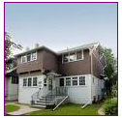


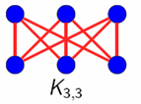



Planar graph without edges crossing ?

Slide 7
Definition 1
A graph is called planar if it can be drawn in the plane without any edges crossing (where a crossing of edges is the intersection of the lines or arcs representing them at a point other than their common endpoint).
Such a drawing is called a planar representation of the graph.

Slide 8
Example 1
K4 is planar because it can be drawn without crossing.

Slide 9
Example 2
Q3 is planar because it can be drawn without crossing.

Slide 10
Example 3
v1
v2
v3
v4
v5
v6
(v2, v4), (v3, v4), (v3, v5), (v2, v5)

Slide 11
v1
v2
v3
v4
v5
v6
In any planar representation of K(3,3), the vertices v1 and v2 must be connected to both v4 and v5.

Slide 12
v1
v2
v1
v5
v3
R21
R1
R2
R22
v4
v5
v4
v2
These four edges form a cure that splits the plane into two regions R1 and R2.
The vertex v3 is in either R1 or R2. When v3 is in R2, its incident edges separate R2 into R21 and R22

Slide 13
v1
v2
v6
v3
R21
R1
R2
v6
R22
v6
v4
v5
Whenever v6 is in R1, R21 or R22, its incident edges cannot be draw without crossing.

Slide 14
Planar graph without edges crossing ?
Therefore, three houses and three utilities cannot be connected in the plane without crossing.

Slide 15
Application of planar graph
Planarity of graphs play an important role in the design of electronic circuits.
We can model a circuit with a graph by representing components of the circuit by vertices and connections between them by edges.
We can print a circuit on a single board with no connections crossing if the graph representing the circuit is planar.

Slide 16
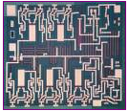

Application of planar graph
When this graph is not planar, we must turn to more expensive options. We need construct the circuit using multiple layer.

Slide 17
Euler’s Formula

Slide 18
A planar representation of a graph splits the plane into regions, including an unbounded region.
R4
R2
R3
R6
R1
R5

Slide 19
R4
R2
R3
R6
R1
R5
Euler showed that all planar representations of a graph split the plane into the same number of regions.
He found a relation among the number of regions, the number of vertices, and the number of edges of a planar graph.

Slide 20
Euler’s Formula
Theorem 1: Let G be a connected planar simple graph with e edges and v vertices.
Let r be the number of regions in a planar representation of G. Then r = e – v + 2.
Proof :
First, we specify a planar representation of G.
We construct a sequence of subgraphs G₁, G₂, …, Ge = G, adding an edge at each stage.

Slide 21
Euler’s Formula
Arbitrarily pick one edge of G to obtain G1.
Obtain Gn from Gn-1 by arbitrarily adding an edge that is incident with a vertex already in Gn-1, adding the other vertex incident with this edge if it is not already in Gn-1.
This construction is possible for G is connected.
G is obtained after e edges are added.
Let rn, en and vn represent the number of regions, edges, and vertices of the planar representation of Gn induced by the planar representation of G.

Slide 22
Euler’s Formula
The proof will continue by induction.
The relationship r₁ = e₁ – v₁ + 2 is true for G₁, since e₁=1, v₁=2, and r₁=1.
R1
u1
u2
Assume that r_{n} = e_{n} –v_{n} +2.
Let {a_{n+1}, b_{n+1}} be the edge that is added to Gn to obtain Gn-1.

Slide 23
Euler’s Formula
There are two possibilities to consider.
(1) both a_{n+1} and b_{n+1} are already in Gn.
These two vertices must be on the boundary of a common region R, or else it would be impossible to add the edge {a_{n+1}, b_{n+1}} to Gn without two edges crossing (Gn+1 is planar).
a_{n+1}
R
b_{n+1}

Slide 24
The addition of this new edges splits R into two Regions.
In this case, r_{n+1} = r_{n} + 1, e_{n+1} = e_{n} + 1 and v_{n+1} = v_{n}.
Thus, r_{n+1} = e_{n+1} – v_{n+1} +2 is still true.
a_{n+1}
R
b_{n+1}

Slide 25
Euler’s Formula
(2) One of the two vertices of the new edge is not already in Gn.
Suppose that an+1is in Gn but that bn+1 is not.
Adding this new edge does not produce any new regions, since bn+1 must be in a region that has an+1 on its boundary.
an+1
R
bn+1

Slide 26
Euler’s Formula
an+1
R
bn+1
Consequently, r_{n+1}=r_{n}. Moreover, e_{n+1}=e_{n}+1 and v_{n+1}=v_{n}+1.
Each side of the formula relating the number of regions, edges, and vertices remains the same.
r_{n+1} = e_{n+1} – v_{n+1} + 2

Slide 27
Euler’s Formula
Hence, we can use mathematical induction to form the conclusion that
r_{n} = e_{n} – v_{n} + 2 for all n
since r1 = e1 –v1 +2
and r_{k+1} = e_{k+1} – v_{k+1} + 2 is true
if r_{k} = e_{k} – v_{k} + 2 is true.
Since the original graph is the graph Ge, obtained after e edges have been added, the theorem is true.

Slide 28
Example 4
Suppose that a connected planar simple graph has 20 vertices, each of degree 3.
How many regions does a representation of this planar graph split the plane?
This graph has 15 vertices, each of degree 4, so that v = 15.
Because 2e = 15 * 4 =60, e =30.
Hence, r = e – v + 2 = 30 - 15 +2 = 17.

Slide 29
Corollary 1
Corollary 1: If G is a connected planar simple graph with e edges and v vertices where v ≥ 3, the e ≤ 3v -6.
Proof: A connected planar simple graph drawn in the plane divides the plane into r regions.
The degree of each region is at least three.
In particular, the degree of the unbounded region is at least three since there are at least three vertices in the graph.

Slide 30
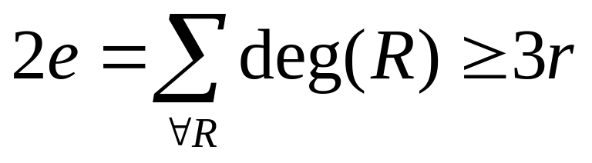
Corollary 1
Proof: The sum of the degrees of the regions is exactly twice the number of edges in the graph,because each edge occurs on the boundary of a region exactly twice.
Since each region has degree greater than or equal to three, it follows that

Slide 31
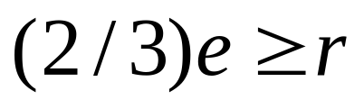
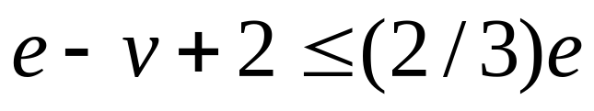
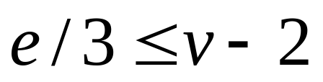
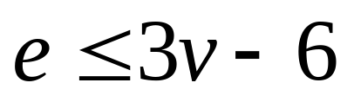
Corollary 1

Slide 32
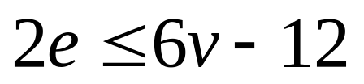
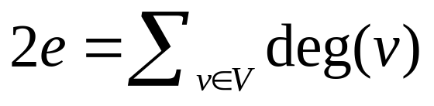
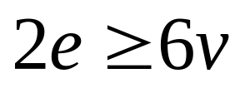
Corollary 2
Corollary 2: If G is a connected planar simple graph, then G has a vertex of degree not exceeding five.
Proof: If G has one or two vertices, the result is true. If G has at least three vertices, by Corollary 1 we have that
If the degree of every vertex were at least six,
Thus, G has a vertex with degree no greater than 5.

Slide 33
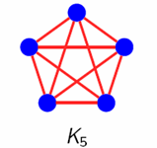
Example 5
Show that K5 is nonplanar using Corollary 1.
Solution: The graph K5 has 5 vertices and 10 edges. Thus, e = 10 and 3v – 6 = 9.
Hence, e ≤3v – 6 is not satisfied.
Therefore, K5 is not planar.

Slide 34
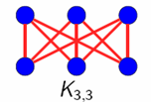
Another Example
The graph K3,3 has 6 vertices and 9 edges.
e = 9 ≤ 12 =3 * 6 – 6 is satisfied.
However, the satisfied e ≤3v – 6 does not imply that a graph is planar.

Slide 35
Corollary 3
Corollary 3: If G is a connected planar simple graph has e edges and v vertices with v ≥ 3 and no circuits of length three, e ≤ 2v - 4.
Proof: A connected planar simple graph drawn in the plane divides the plane into r regions.
The degree of each region is at least 4.
In particular, the degree of the unbounded region is at least 4 since there are at least 4 vertices in the graph.

Slide 36
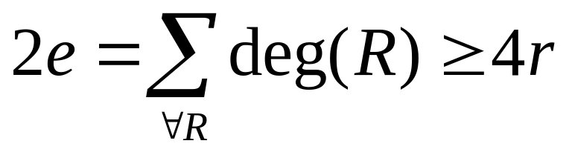
Corollary 3
Proof: The sum of the degrees of the regions is exactly twice the number of edges in the graph,
because each edge occurs on the boundary of a region exactly twice.
Since each region has degree greater than or equal to 4, it follows that

Slide 37
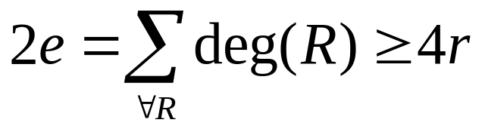
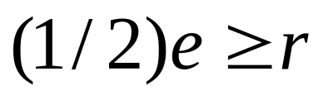
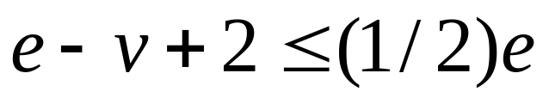
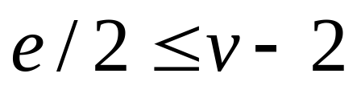
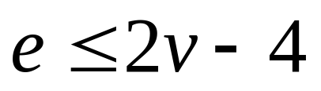
Corollary 3

Slide 38
Another Example
The graph K3,3 has 6 vertices and 9 edges.
e = 9 and 2v-4 = 8 .
Corollary 3 shows that K3,3 is nonplanar.

Slide 39
Kuratowski’s Theorem

Slide 40
Kuratowski’s Theorem
If a graph is planar, so any graph will be obtained by removing an edge {u, v} and adding a new vertex w with {u, w} and {w, v}.
This operation is called an elementary subdivision.
The graphs G1=<V1, E1> and G2=<V2, E2> are called homeomorphic if they can be obtained from the same graph by a sequence of elementary subdivisions.

Slide 41
Homeomorphic Graphs
a
G1
a
G2
b
b
f
h
g
c
e
c
e
d
d
a
G3
b
G2 and G3 are obtained from G1 by elementary subdivisions.
k
i
j
g
c
e
d

Slide 42
Theorem 2
A graph is nonplanar if and only if it contains a subgraph homeomorphic to K3,3 or K5.
A graph containing a subgraph homeomorphic
to K3,3 or K5 is nonplanar.
The proof is complicated and will not be given here.

Slide 43
Example 7
a
b
a
b
k
h
c
c
i
d
i
d
f
e
f
e
g
g
G
H
G has a subgraph H homeomorphic to K5. H is obtained by deleting h and k，and all edges incident with these vertices.

Slide 44
Example 7
a
b
a
b
c
c
i
d
i
f
e
g
g
H
K5
H is homeomorphic to K5 since it can be obtained from K5 (with vertices a, b, c, g and i) by a sequence of elementary subdivisions adding vertices d, e, and f.

Slide 45
Example 7
a
b
a
b
j
c
i
d
f
e
c
g
k
h
H
i
d
f
e
g
G
c
G is nonplanar.
i
g
K5

Slide 46
Example 8
a
f
e
f
b
j
g
j
g
i
h
i
h
d
c
d
c
(a’)
(a)
The subgraph H of the Petersen graph obtained by deleting b and the three edges that have b as an endpoint, is homeomorphic to K3,3.

Slide 47
a
c
f
d
j
f
e
a
g
j
g
i
h
e
i
h
d
c
(a’)
(b)
b is homeomorphic to K3,3 with vertex sets {f, d, j} and {e, i, h}, since it can be obtained by deleting {d ,h}, {e, f} and {i, j} and adding {c, h}, {c, d}, {a, e}, {a, f}, {g, i} and {g, j}.

Slide 48
c
f
d
j
g
a
e
i
h
(b)
deleting {d ,h}, {e, j} and {f, h} and a.
adding {d, h}, {f, h} and {j, e}.

Slide 49
Applications

Slide 50
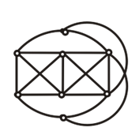
Applications
1.证明下图不是平面图

Slide 51
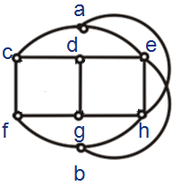
Applications
1.证明下图不是平面图
a
c
d
e
f
g
h
b
解：该图与K_{3,3}有类似的结构，我们尝试通过判断其与K_{3,3}同胚从而证明不是平面图（因为K_{3,3}不是平面图）。
（1）根据K_{3,3}，应当将原图的6个顶点平均分成2组，组内的顶点互不相连，而每个顶点的度数都为3。我们分别选取点c,g,e和点f,d,h作为2组的顶点。
（2）由于组内顶点不相连，故删除边cg,fd,dh,ge。

Slide 52
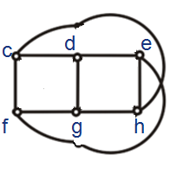
Applications
1.证明下图不是平面图
（2）由于组内顶点不相连，故删除边cg,fd,dh,ge。
（3）由于点c和点h需要相连，故移除点a和边ae。同理移除点b和边bh。

Slide 53
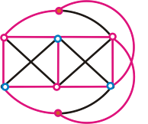
Applications
1.证明下图不是平面图
与K_{3,3}同胚，也可收缩到K_{3,3} 。由于K_{3,3}不是平面图，因此原图不是平面图

Slide 54
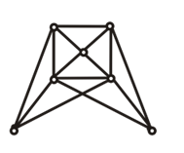
Applications
2.证明下图不是平面图

Slide 55
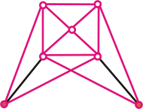
Applications
2.证明下图不是平面图
a
b
c
d
e
f
g
解：该图与K₅有类似的结构，我们尝试通过判断其与K_{3,3}同胚从而证明不是平面图（因为K₅不是平面图）。
首先移除度数不够4的顶点（因为K₅中每个顶点度数都为4），即移除顶点f和顶点g。
移除顶点f和顶点g后，边fd和边eg也随之移除。得到

Slide 56
Applications
2.证明下图不是平面图
与K₅同胚，也可收缩到K₅ 。由于K₅不是平面图，因此原图不是平面图

Slide 57
End of Section 6.7
Click to edit company slogan .

